Slide 1

PCET’s Pimpri Chinchwad College of Engineering
Department of Computer Engineering
Project Based Learning-4
Title- Heart Attack Prediction Name: Sachin Girawale TYCOB074
Janhavi Kahare TYCOB099
Aneesh Kanhere TYCOB106
Under the guidance of Dr./Prof.- K.Rajeshwari

Slide 2
Introduction
Heart attacks, or myocardial infarctions, represent acute and often life-threatening events within the spectrum of cardiovascular diseases. Globally, heart attacks stand as a leading cause of mortality, underscoring the critical need for accurate risk prediction and early intervention strategies [1]. Despite advancements in medical science, heart attacks continue to pose significant challenges, necessitating innovative approaches for timely detection and preventive measures.
Objective:
The objective of this research paper is to explore the role of heart attack prediction models in enhancing preventive healthcare strategies, by investigating their effectiveness in identifying individuals at high risk of heart attacks, facilitating early intervention, promoting personalized medicine, optimizing resource allocation, empowering patients through education, and driving ongoing research and development efforts in cardiovascular medicine

Slide 3
Data Exploration:
Dataset Overview:
The dataset consists of 1025 entries with 14 features, including patient ID, demographic information, lifestyle factors, and medical history.
The target variable is "Heart Attack Risk," indicating whether a patient is at risk of a heart attack.
Data Preprocessing:
Checked for null values and duplicated entries, and found none.
Normalized numerical features using Min-Max scaling.
Feature Selection:
Utilized technique such SelectKBest to select relevant features.
The selected features include demographic information, lifestyle factors, and medical history, which play crucial roles in predicting heart attack risk.

Slide 4
LITERATURE REVIEW:
Paper 1: A Review: Heart Disease Prediction in Machine Learning & Deep Learning
The paper emphasizes the increasing prevalence of heart disease globally and highlights the importance of early diagnosis and prevention. It discusses the potential of machine learning and deep learning in predicting heart disease, noting variations in accuracy among different algorithms. The study concludes that deep learning outperforms machine learning in healthcare analytics, offering consistency and high accuracy in predicting heart disease.
Paper 2: Machine Learning-Based Model to Predict Heart Disease in Early Stage Employing Different Feature Selection Techniques
This study addresses the significance of early detection in reducing mortality rates due to heart disease. It proposes a machine learning model for predicting heart disease at an early stage, employing feature selection techniques and various machine learning algorithms. The research finds that random forest achieves the most optimistic performance in predicting heart disease using selected feature subsets. The study suggests the potential clinical use of the proposed model for early-stage heart disease prediction with low cost and time.

Slide 5
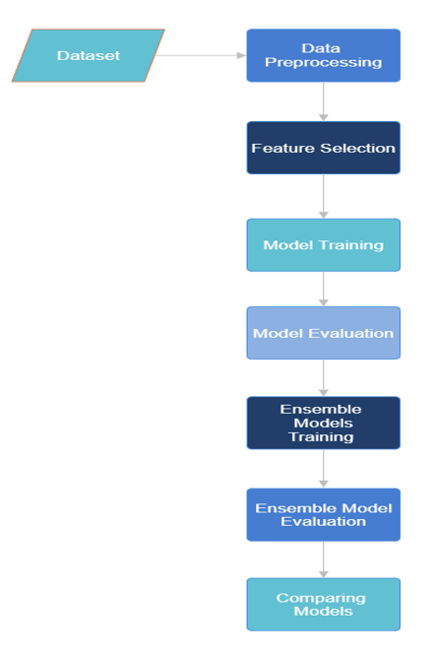
Approach

Slide 6
Feature Selection:
The SelectKBest method from the sci-kit-learn library is used for feature selection based on the f_classif score function, which computes the ANOVA F-value for the features. This technique ranks the features by their importance in predicting the target variable. In this specific case, the top 5 selected features are 'exang', 'thalach', 'ca', 'oldpeak', and 'cp'. These features are deemed most relevant for predicting the target variable based on their ANOVA F-values. For instance, 'exang' represents exercise- induced angina, 'thalach' indicates the maximum heart rate achieved during exercise, 'ca' stands for the number of major vessels colored by fluoroscopy, 'oldpeak' is the ST depression induced by exercise relative to rest, and 'cp' denotes the chest pain type. These features are essential in determining the likelihood of a heart attack, making them key factors in the predictive model.

Slide 7
Model Building and Evaluation:
ML Classifier | Training Accuracy | Testing Accuracy
Random Forest | 96.10% | 98.05%
Logistic Regression | 81.11% | 82.46%
Naïve Bayes | 79.80% | 79.22%
Support Vector Machine | 85.71% | 88.96%
K-Nearest Neighbours | 88.33% | 87.66%
Neural Network | 90.20% | 90.90%
Gradient Boosting | 91.55% | 91.55%
Voting Classifier (LR+GB) | 98.2% | 94.16%
Proposed Approach Stacking Classifier (LR+GB+RF+SVM) | 95.45% | 97.40%
Comparison:
These results provide valuable insights into the performance of proposed model and other classifiers, highlighting their strengths and weaknesses in predicting obesity levels. Overall, the training and evaluation process underscores the potential of machine learning algorithms in addressing public health challenges through data-driven approaches.
These findings offer valuable insights into the performance of both the proposed model and alternative classifiers, illuminating their respective capabilities and limitations. Through the training and evaluation process, it becomes evident that machine learning algorithms possess significant potential in tackling public health challenges by leveraging data-driven methodologies

Slide 8
Future Scope
The heart attack prediction task has demonstrated the effectiveness of various machine learning models and ensemble techniques. To further enhance the predictive accuracy and applicability of the models, several future directions can be considered. Firstly, incorporating more advanced deep learning models, such as convolutional neural networks (CNNs) or recurrent neural networks (RNNs), could potentially capture complex patterns in the data and improve prediction performance. Additionally, integrating more diverse and comprehensive features, such as genetic data or lifestyle factors, could provide a more holistic understanding of heart attack risk. Furthermore, exploring the use of explainable AI techniques to interpret model predictions could enhance the trust and adoption of these models in clinical practice. Overall, continued research and development in these areas hold the potential to significantly advance the field of heart attack prediction and improve patient outcomes in the future.

Slide 9
Conclusion:
The heart attack prediction task utilized various machine learning models, including Random Forest, Logistic Regression, Naïve Bayes, Support Vector Machine, K- Nearest Neighbors, Neural Network, and Gradient Boosting. A Voting Classifier combining Logistic Regression and Gradient Boosting, as well as a Stacking Classifier with LR, GB, RF, and SVM, were also employed.
Among the individual models, Random Forest achieved the highest training accuracy of 96.10%, while the Voting Classifier (LR+GB) achieved the highest testing accuracy of 94.16%. However, on the testing set, Random Forest performed the best, with an accuracy of 98.05%.
The Stacking Classifier, combining Logistic Regression, Gradient Boosting, Random Forest and Support Vector Machine achieved a training accuracy of 95.45% and a testing accuracy of 97.40%, demonstrating strong generalization to unseen data. In conclusion, combining traditional machine learning models and ensemble techniques led to a competitive performance in heart attack prediction, showing promise for real-world applications in healthcare.

Slide 10
References:
Md. I. Hossain et al., “Heart disease prediction using distinct artificial intelligence techniques: performance analysis and comparison,” Iran Journal of Computer Science, vol. 6, no. 4, pp. 397–417, Dec. 2023, doi: 10.1007/s42044-023-00148-7.
A. Yazdani, K. D. Varathan, Y. K. Chiam, A. W. Malik, and W. A. Wan Ahmad, “A novel approach for heart disease prediction using strength scores with significant predictors,” BMC Med Inform Decis Mak, vol. 21, no. 1, Dec. 2021, doi: 10.1186/s12911-021-01527-5.
R. Indrakumari, T. Poongodi, and S. R. Jena, “Heart Disease Prediction using Exploratory Data Analysis,” in Procedia Computer Science, Elsevier B.V., 2020, pp. 130–139. doi: 10.1016/j.procs.2020.06.017.
C. A. ul Hassan et al., “Effectively Predicting the Presence of Coronary Heart Disease Using

